Slide 1
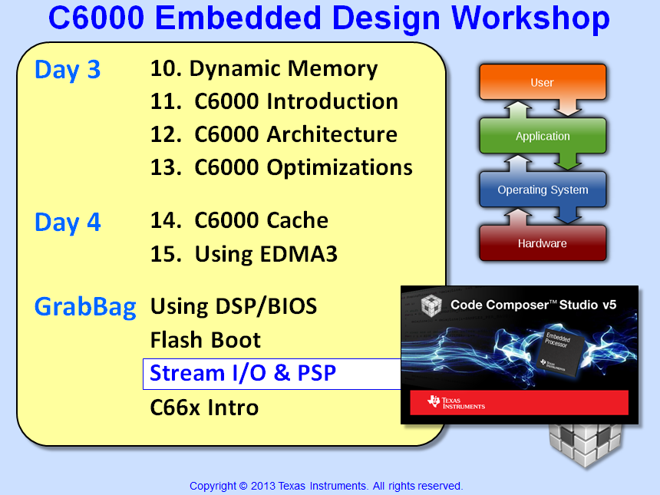

Slide 2
Objectives
Analyze BIOS streams – SIO – and the key APIs used
Adapt a TSK to use SIO (Stream I/O)
Describe the benefits of multi-buffer streams
Learn the basics of PSP drivers

Slide 3
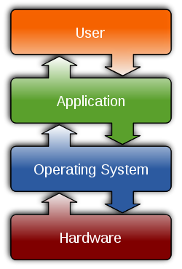

Outline
Driver I/O - Intro
Using Double Buffers
PSP/IOM Drivers

Slide 4
Basic Real-time System Design (IPO)
IOM/PSP
Stream I/O
IOM/PSP
Input
Process
Output
Input
(Driver)
User Program
“master thread”
Output
(Driver)
input source data
export results
Process
(algorithm)
Convert input data to desired results

Slide 5

Using Queues in a System…
User Setup:
Declare Queue in CFG
Define (typedef) structure of Msg
Fill in the Msg – i.e. define “elements”
Send/receive data from the queue
struct myMsg {
Queue_Elem elem;
short *pInBuf;
short *pOutBuf;
} Msg;
Example – RCV side of peripheral driver (Hwi):
Double Buffer System – main init puts TWO Msgs in toDevQ
HWI gets EMPTY Buffer from toDevQ (and fills it up with data)
main
put
put
HWI puts FULL Buffer into toTSKQ (gets next EMPTY)
TSK gets FULL buffer from toTSKQ (process)
1
TSK puts EMPTY buffer into toDevQ
get
Hwi
put
2
toDevQ
5
put
Task
get
Note: two Queues allow Msgs to circulate between threads.
toDevQ = EMPTY, toTSKQ =FULL
3
toTSKQ
4

Slide 6
Basic Driver API (SYS/BIOS Stream I/O)
PSP
PSP
Input IOM
issue
Task
issue
Output IOM
SIO
MY_DSP_algo
SIO
reclaim
reclaim
Stream I/O: interface between TSKs and Devices
Universal interface to I/O devices
# of buffers and buffer size are user selectable
Unidirectional: streams are input or output - not both
Efficiency: uses pointer exchange instead of buffer copy
APIs:
Stream_issue() – passes buffer to the stream
Stream_reclaim() – requests buffer from stream, blocks until available

Slide 7
Master Thread – Accessing I/O (BIOS)
// Create Phase (single buffer)
status = Stream_issue(inStream, pBufIn, size); // issue EMPTY buffer to inStream
status = Stream_issue(outStream, pBufOut, size); // issue EMPTY buffer to OutStream
while( doRecordVideo == 1 ) { // Execute phase
inSize = Stream_reclaim (inStream, pBufIn); // get FULL input buffer
outSize = Stream_reclaim (outStream, pBufOut); // get EMPTY output buffer
… DO DSP … // Algo goes here
status = Stream_issue(inStream, pBufIn, size); // issue EMPTY buffer to inStream
status = Stream_issue(outStream, pBufOut, size); // issue FULL buffer to OutStream
}
Stream_reclaim (inStream, pBufIn); // Delete phase
Stream_reclaim (outStream, pBufOut); // retrieve buffers back from stream
Notes:
Code example here is for a speech recorder.
Input type is a ‘device’ (as hinted to by the file descriptor I def fd – input device file descriptor) and
the output is a ‘file’ (again, going off the ‘o file fd’ output file descriptor)
Third line – ioctl – IO control – is an example of what is usually several lines of control information required to fully set up each IO device
Engine open – required to startup the VISA control functions that enable easy dual-processor usage
SPH ENC (speech encoder) create – sets up the algo named ‘sphenc’ within the speech encoder engine: allocating needed ram, setting its params, etc
The next segment of code is the ‘execute’ phase, that should run in a while loop for as long as the speech recording is desired.
First, a new buffer of data is acquired from the input device. As noted in the ‘note’ below, this peripheral API is not likely the best choice in a real-time system, since it does not usually support double buffer exchange, as is often essential to maintaining uninterrupted data flow. (refer to the peripheral chapter for ways to better implement double buffering).
Next, there are shown two VISA API to the example speech encoder. The first is the ‘control’ function, which allows master thread authors to control the behaviour of algos in a well defined manner. All speech encoders will share the same control functions. Each of the VISA enc/dec oders will have a control set that all such algos will respect.
The SPHENC_process call is the key VISA API to run the speech encoder. As with the control API just described, the process function is common to any algo implementing speech encoding, so the master thread author can use any candidate algo of this type without rewriting the master code. Each of the VISA e/d groups similarly have a common style defined for their processing function.
Finally, in the delete phase, the close API halt the peripherals and return them to the OS for later use by other threads. Similarly, the SPHENC delete function is used to return all RAM resources borrowed from the heap in the SPHENC_Create phase so that this memory is available subsequently for other purposes.
The Engine close API is used when the VISA environment is no longer required. It is not mandatory to call, but demonstrates the complementary function to the engine open API above.

Slide 8
Outline
Driver I/O - Intro
Using Double Buffers
PSP/IOM Drivers

Slide 9
Double Buffer Example – Input Only
IOM Device
Task
Input Stream
int pBuf_1[SIZE];
int pBuf_2[SIZE];
BIOS:
Stream
status = Stream_issue(hStrm, pBuf_1, …);
status = Stream_issue(hStrm, pBuf_2, …);
empty
ToDeviceQUE
empty
empty
empty
while(…)
{
size = Stream_reclaim(hStrm, &pBuf_x,…);
// process & send output
status = Stream_issue(hStrm, pBuf_x, …);
}
FULL
FromDeviceQUE
FULL
empty
ToDeviceQUE
empty
size = Stream_reclaim(hStrm, &pBuf_1, …);
size = Stream_reclaim(hStrm, &pBuf_2, …);
Example only shows “input stream”. Must also double-buffer “output stream”.

Slide 10
Double Buffer Stream TSK Coding Example
//prolog – prime the process…
status = SIO_issue(&sioIn, pIn1, SIZE, NULL); status = SIO_issue(&sioIn, pIn2, SIZE, NULL);
status = SIO_issue(&sioOut, pOut1, SIZE, NULL); status = SIO_issue(&sioOut, pOut2, SIZE, NULL);
//while loop – iterate the process…
while (condition == TRUE){ size = SIO_reclaim(&sioIn, (Ptr *)&pInX, NULL); size = SIO_reclaim(&sioOut, (Ptr *)&pOutX, NULL);
// DSP... to pOut
status = SIO_issue(&sioIn, pInX, SIZE, NULL); status = SIO_issue(&sioOut, pOutX, SIZE, NULL); }
//epilog – wind down the process…
status = SIO_flush(&sioIn); //stop input status = SIO_idle(&sioOut); //idle output, then stop
size = SIO_reclaim(&sioIn, (Ptr *)&pIn1, NULL); size = SIO_reclaim(&sioIn, (Ptr *)&pIn2, NULL);
size = SIO_reclaim(&sioOut, (Ptr *)&pOut1, NULL); size = SIO_reclaim(&sioOut, (Ptr *)&pOut2, NULL);
Notes:
This is a fairly ‘tricky’ coding solution, with many subtle solutions to problems seldom thought of.
It is recommended that you highlight the points below to make the code well understood to the students:
we presume that 4 buffers were obtained : pBuf In1 and 2 , Out 1 and 2
notice that we issue both input buffers to begin and then wait for 1 to come back
we store the ptr to the reclaimed input buffer as pInX – a ‘temporary’ pointer to the recently reclaimed buffer
we do the DSP on the 1st input buf and store the results in the 1st output buf – but we DON’T send the buf out yet – this is critical – and subtle, so please point this out: If we sent out the 1st output buf NOW we’d never have time to load TWO buffers to the output, since by the time there is a new input buffer, the output buffer we just sent would also have just drained, so the output would have two buffers available, but never would have 2 buffers worth of results on hand at any time. To solve this REALLY hard to visualize problem, we HOLD the 1st output buffer until we have BOTH ready to send. At this point, we can wait for a new input, and have a freshly emptied output buffer to put results into – perfect balance of input and output loading
we reissue the used input buffer back to the in stream for refilling
and wait for the 2nd buffer to fill and be reclaimed. we block until the 2nd buffer comes in, as we do in all reclaims
with the 2nd buffer in, we perform DSP on the new buffer and produce the 2nd output buffer results
NOW we can send BOTH output buffers to the out stream & underlying out device, which gives us proper “double buffering” on the output side
finally, we re-issue the used 2nd buffer back to the in stream
at this point, all 4 buffers are ‘out’ in stream and device, so the 1st two reclaims in the while loop that follows will each block until a buffer fill/empty period has concluded, at which time we’ll get back another in and out ptr to do DSP through
in the loop we obtain a ready to use block on BOTH the in and out streams, then do DSP on the IN block, putting the results in the OUT block
the empty in buffer is returned to the in stream to be re-filled. the new out data is sent via the out stream to the out device
this loop could continue forever, or until any author defined ‘condition’ is true (end of data signal, user throws switch to turn off thread, etc)
if loop can terminate, the epilog script will run at this point
both streams are idled, which turns off each device and inhibits them from obtaining new interrupt signals. The choice of flush or idle is up to the author
The final reclaims are technically required, but don’t actually serve a purpose in the code above. The final reclaim does two things:
it gives back the final pointer to the buffers that were outstanding
it ‘proves’ the stream and device are no longer in possession of these resources
However, this code doesn’t need the return of the pointer, since we never overwrote their original values, still available in pIn1 and 2 and out 1 and 2. We used the ‘x’ pointer which has been overwritten instead with ever different pointer values. So, if we were going to do a ‘free’ at this point to release heap resources, we could refer back to the ‘1’ and ‘2’ pointers and not worry about the x pointer at all. As to the 2nd value: the ‘proof’ that the block was no longer in use by the SIO or IOM, this is assuerd by the return of the flush or idle already, so there is no need to obtain proof of this again, thus these last two lines will be seen commonly in system examples, but are probably not worth keeping in code such as that shown here.
Lastly, it is good to note that the pro/epi logs run 1x each, and maybe never for the epilogue. However, the while loop often runs MANY times over, many times ‘forever’ in the life of the system. No follow-on point, just the notion that this is the way this code usually runs, so the students can see this general approach.
SUGGESTION: IN ADVANCED CLASSES, WHERE TIME AND INTEREST ALLOW, CONSIDER DEMONSTRATING HOW TO SCALE THIS SOLUTION TO A 3 BUFFER SOLUTION. IT MIGHT EVEN BE BENEFICIAL IF STUDENTS ARE DOING WELL WITH THE CONCEPTS TO HAVE **THEM** WORK OUT THE 3 BUFFER SOLUTION. ANOTHER OPTION: EXTRAPOLATE THE SOLUTION TO AN ‘N’ BUFFER GENERAL SOLUTION. THE SOLUTIONS TO THESE EXERCISES ARE PROVIDED AT THE END OF THE CHAPTER IN THE ‘OPTIONAL’ SECTION. PRESENTING THESE EXTRA SLIDES IS NOT REQUIRED, AND NOT RECOMMENDED FOR NOVICE CLASSES OR WHEN TIME OR INTEREST IN THE SUBJECT IS NOT AVAILABLE.

Slide 11
Double Buffer Stream TSK Coding Example
//prolog – prime the process…
status = SIO_issue(&sioIn, pIn1, SIZE, NULL); status = SIO_issue(&sioIn, pIn2, SIZE, NULL);
size = SIO_reclaim(&sioIn, (Ptr *)&pInX, NULL); // DSP... to pOut1 status = SIO_issue(&sioIn, pInX, SIZE, NULL);
size = SIO_reclaim(&sioIn, (Ptr *)&pInX, NULL); // DSP... to pOut2 status = SIO_issue(&sioIn, pInX, SIZE, NULL);
status = SIO_issue(&sioOut, pOut1, SIZE, NULL); status = SIO_issue(&sioOut, pOut2, SIZE, NULL);
//while loop – iterate the process…
while (condition == TRUE){ size = SIO_reclaim(&sioIn, (Ptr *)&pInX, NULL); size = SIO_reclaim(&sioOut, (Ptr *)&pOutX, NULL);
// DSP... to pOut
status = SIO_issue(&sioIn, pInX, SIZE, NULL); status = SIO_issue(&sioOut, pOutX, SIZE, NULL); }
//epilog – wind down the process…
status = SIO_flush(&sioIn); //stop input status = SIO_idle(&sioOut); //idle output, then stop
size = SIO_reclaim(&sioIn, (Ptr *)&pIn1, NULL); size = SIO_reclaim(&sioIn, (Ptr *)&pIn2, NULL);
size = SIO_reclaim(&sioOut, (Ptr *)&pOut1, NULL); size = SIO_reclaim(&sioOut, (Ptr *)&pOut2, NULL);
Notes:
This is a fairly ‘tricky’ coding solution, with many subtle solutions to problems seldom thought of.
It is recommended that you highlight the points below to make the code well understood to the students:
we presume that 4 buffers were obtained : pBuf In1 and 2 , Out 1 and 2
notice that we issue both input buffers to begin and then wait for 1 to come back
we store the ptr to the reclaimed input buffer as pInX – a ‘temporary’ pointer to the recently reclaimed buffer
we do the DSP on the 1st input buf and store the results in the 1st output buf – but we DON’T send the buf out yet – this is critical – and subtle, so please point this out: If we sent out the 1st output buf NOW we’d never have time to load TWO buffers to the output, since by the time there is a new input buffer, the output buffer we just sent would also have just drained, so the output would have two buffers available, but never would have 2 buffers worth of results on hand at any time. To solve this REALLY hard to visualize problem, we HOLD the 1st output buffer until we have BOTH ready to send. At this point, we can wait for a new input, and have a freshly emptied output buffer to put results into – perfect balance of input and output loading
we reissue the used input buffer back to the in stream for refilling
and wait for the 2nd buffer to fill and be reclaimed. we block until the 2nd buffer comes in, as we do in all reclaims
with the 2nd buffer in, we perform DSP on the new buffer and produce the 2nd output buffer results
NOW we can send BOTH output buffers to the out stream & underlying out device, which gives us proper “double buffering” on the output side
finally, we re-issue the used 2nd buffer back to the in stream
at this point, all 4 buffers are ‘out’ in stream and device, so the 1st two reclaims in the while loop that follows will each block until a buffer fill/empty period has concluded, at which time we’ll get back another in and out ptr to do DSP through
in the loop we obtain a ready to use block on BOTH the in and out streams, then do DSP on the IN block, putting the results in the OUT block
the empty in buffer is returned to the in stream to be re-filled. the new out data is sent via the out stream to the out device
this loop could continue forever, or until any author defined ‘condition’ is true (end of data signal, user throws switch to turn off thread, etc)
if loop can terminate, the epilog script will run at this point
both streams are idled, which turns off each device and inhibits them from obtaining new interrupt signals. The choice of flush or idle is up to the author
The final reclaims are technically required, but don’t actually serve a purpose in the code above. The final reclaim does two things:
it gives back the final pointer to the buffers that were outstanding
it ‘proves’ the stream and device are no longer in possession of these resources
However, this code doesn’t need the return of the pointer, since we never overwrote their original values, still available in pIn1 and 2 and out 1 and 2. We used the ‘x’ pointer which has been overwritten instead with ever different pointer values. So, if we were going to do a ‘free’ at this point to release heap resources, we could refer back to the ‘1’ and ‘2’ pointers and not worry about the x pointer at all. As to the 2nd value: the ‘proof’ that the block was no longer in use by the SIO or IOM, this is assuerd by the return of the flush or idle already, so there is no need to obtain proof of this again, thus these last two lines will be seen commonly in system examples, but are probably not worth keeping in code such as that shown here.
Lastly, it is good to note that the pro/epi logs run 1x each, and maybe never for the epilogue. However, the while loop often runs MANY times over, many times ‘forever’ in the life of the system. No follow-on point, just the notion that this is the way this code usually runs, so the students can see this general approach.
SUGGESTION: IN ADVANCED CLASSES, WHERE TIME AND INTEREST ALLOW, CONSIDER DEMONSTRATING HOW TO SCALE THIS SOLUTION TO A 3 BUFFER SOLUTION. IT MIGHT EVEN BE BENEFICIAL IF STUDENTS ARE DOING WELL WITH THE CONCEPTS TO HAVE **THEM** WORK OUT THE 3 BUFFER SOLUTION. ANOTHER OPTION: EXTRAPOLATE THE SOLUTION TO AN ‘N’ BUFFER GENERAL SOLUTION. THE SOLUTIONS TO THESE EXERCISES ARE PROVIDED AT THE END OF THE CHAPTER IN THE ‘OPTIONAL’ SECTION. PRESENTING THESE EXTRA SLIDES IS NOT REQUIRED, AND NOT RECOMMENDED FOR NOVICE CLASSES OR WHEN TIME OR INTEREST IN THE SUBJECT IS NOT AVAILABLE.

Slide 12
Outline
Driver I/O - Intro
Using Double Buffers
PSP/IOM Drivers
Stream Configuration
For More Info…

Slide 13
Outline
Driver I/O - Intro
Using Double Buffers
PSP/IOM Drivers
Stream Configuration
For More Info…

Slide 14




Stream Configuration
TSK
4 – use stream
“Use”
Cfg: Static (GUI) or Dynamic
sioIn
SIO
SIO
3 – define stream
“Stream”
DIO
DIO
2 – tie in DIO adapter
“Door”
PSP/IOM
1 – register IOM
“Room”
A/D
D/A
0 – build HW
PSP – Platform Support Package (a collection of IOM-compliant drivers)

Slide 15
Using a PSP/IOM Driver – Procedure (1)
Procedure: Using an IOM/PSP driver
1. Register the IOM-compliant PSP Driver
The heart of each PSP driver is an IOM-compliant mini-driver.
Register via GUI or .tcf. Refer to driver’s sample app and U/G for parameters.
2. Define DIO Adapter (BIOS Class Driver)
Doorway between PSP/IOM and SIO/GIO stream
Define via GUI, tie to specific “device” – i.e. what was created in Step 1.
3. Define Stream (SIO)
Create the stream statically (GUI) or dynamically
Tie the stream to a DIO Adapter
4. Add PSP/IOM Driver Library to Your Project

Slide 16

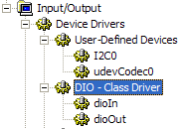
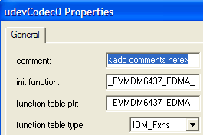
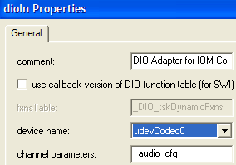
Using a PSP/IOM Driver – Procedure (2)
1. Register IOM/PSP Driver
2. Define DIO Adapter
Register via GUI or .tcf. Refer to driver’s sample app and User Guide for parameters.
Define via GUI and tie to specific “device”

Slide 17
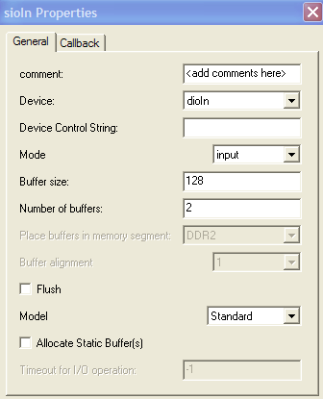
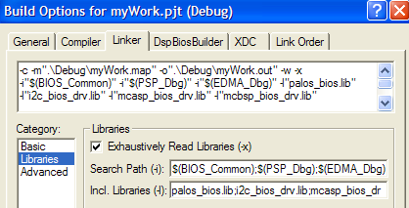
Using a PSP/IOM Driver – Procedure (3)
3. Define Stream (SIO)
4. Add Library to Project
Create the stream statically (GUI) or dynamically
Tie the stream to a DIO Adapter
Either add the library directly to your project or via Build Options
Dynamic Stream Config
sioIn = SIO_create("/dioIn" , SIO_INPUT , 4*BUF, &attrs);
sioOut = SIO_create("/dioOut", SIO_OUTPUT, 4*BUF, &attrs);

Slide 18
Outline
Driver I/O - Intro
Using Double Buffers
PSP/IOM Drivers
Stream Configuration
For More Info…

Slide 19
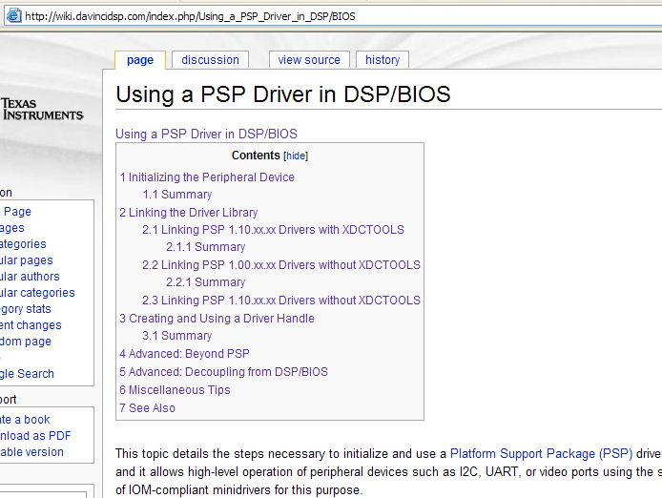
PSP – For More Information (TI Wiki)
Check out the PSP Tutorial on the TI Wiki…

Slide 20
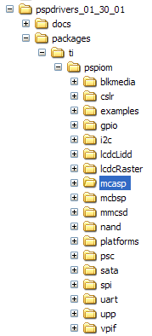
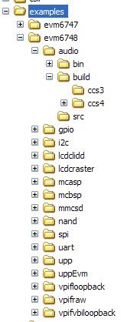

PSP Drivers – Where Are They ?
PSP/IOM drivers are part of the SDK download of your specific device
Questions galore:
Where are they?
Any examples?
Are they documented?
Driver Docs (e.g.)
BIOS PSP Docs

Slide 21


Slide 22
Buffer Passing: SIO_issue() & _reclaim()
status = SIO_issue(hStream, pBuf, uSize, arg);
uSize = SIO_reclaim(hStream, &pBuf, pArg);
SIO_issue() and SIO_reclaim() are the key stream API for exchanging buffers with IOM via the stream interface.
SIO_issue() places a buffer in the stream
SIO_reclaim() requests a buffer from the stream. Note:
if no buffers are already available in the stream, this call can block until a buffer is made available from the IOM
Never attempt a reclaim prior to issuing buffer(s) into the stream first
*pBuf is where SIO_reclaim writes the address of the buffer returned
type | param | usage
Int | status | report of success/failure of operation
Int | uSize | # of used values in block - in nmadus (error = -)
SIO_Handle | hStream | handle to stream obj
Ptr | pBuf | pointer to buffer being stream transferred
Arg | arg | uncommitted gen’l purpose user argument

Slide 23
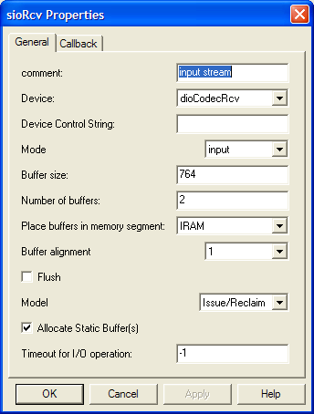
Obtaining Buffers: SIO_staticbuf()
uSize = SIO_staticbuf(hStream, &pBuf);
SIO_staticbuf() returns buffers for statically created streams where the ‘Allocate Static Buffers’ box was checked
SIO_staticbuf() can only be called prior to any SIO_issue or _reclaim call
Dynamic systems use SIO_create() and SIO_delete()
type | param | usage
Int | uSize | size of block obtained - in nmadus (o if no more)
SIO_Handle | hStream | handle to statically created parent stream obj
Ptr | pBuf | pointer to buffer being stream transferred

Slide 24
Halting a Stream: SIO_idle(), SIO_flush()
status = SIO_idle(hStream);
status = SIO_flush(hStream);
SIO_flush() indicates to immediately return all buffers, regardless of state of data (sent, waiting, in progress)
SIO_idle() is
identical to _flush for input streams,
directs output streams to complete sending any remaining ‘live’ data prior to return
blocks the calling task until all output data is sent
In both cases, the underlying driver is idled prior to their return
type | param | usage
Int | Status | report of success/failure of operation
SIO_Handle | hStream | handle to stream obj

Slide 25
“First Available” Stream: SIO_select()
uMask = SIO_select(ahSioTab, nSio, uTimeout);
Wait until one or more streams are ready for I/O
streamtab defines which streams to pend on
Useful for slow-device I/O
Daemon task to route data from several sources
recommended: use newer BIOS messaging API, eg: MSGQ
SIO_Handle hSioIn, hSioOut, ahSioTab[2]; Uns uMask;
ahSioTab [0] = hSioIn; ahSioTab [1] = hSioOut;
uMask = SIO_select(ahSioTab, 2, SYS_FOREVER)
if (uMask == 0x1) { // service streamIn }
if (uMask == 0x2) { // service streamOut }
IOM In
IOM Out
post or post
unblocks
type | param | usage
Uns | uMask | ready stream ID
SIO_Handle | ahSioTab[] | table of streams
Int | nSio | # of streams in table
Uns | uTimeout | max blocking time

Slide 26
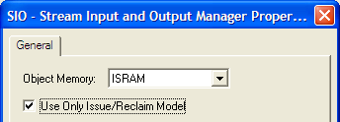
SIO API Summary
Buffer Passing
SIO_issue Send a buffer to a stream
SIO_reclaim Request a buffer back from a stream
SIO_ready Test to see if stream has buffer available for reclaim
SIO_select Wait for any of a specified group of streams to be ready
Stream Management
SIO_staticbuf Obtain pointer to statically created buffer
SIO_flush Idle a stream by flushing buffers
SIO_idle Idle a stream
SIO_ctrl Perform a device-dependent control operation
Stream Properties Interrogation
SIO_bufsize Returns size of the buffers specified in stream object
SIO_nbufs Returns number of buffers specified in stream object
SIO_segid Memory segment used by a stream as per stream object
Dynamic Stream Management (mod.11)
SIO_create Dynamically create a stream (malloc fxn)
SIO_delete Delete a dynamically created stream (free fxn)
Archaic Stream API
SIO_get Get buffer from stream
SIO_put Put buffer to a stream

Slide 27
Single Buffer Example
IOM Device
TASK
BIOS:
Stream
int pBuf[SIZE];
status = SIO_issue(hStrm, pBuf, SIZE, NULL );
while(…)
size = SIO_reclaim(hStrm, &pBuf, NULL);
// process & send output
status = SIO_issue(hStrm, pBuf, SIZE, NULL );
size = SIO_reclaim(hStrm, &pBuf, NULL);
empty
ToDeviceQUE
empty
empty
Input Stream
full
FromDeviceQUE
full
empty
ToDeviceQUE
empty

Slide 28
Triple Buffer Stream Coding Example
//prolog – prime the process… status = SIO_issue(&sioIn, pIn1, SIZE, NULL); status = SIO_issue(&sioIn, pIn2, SIZE, NULL); status = SIO_issue(&sioIn, pIn3, SIZE, NULL);
size = SIO_reclaim(&sioIn, (Ptr *)&pInX, NULL); // DSP... to pOut1
status = SIO_issue(&sioIn, pInX, SIZE, NULL );
size = SIO_reclaim(&sioIn, (Ptr *)&pInX, NULL); // DSP... to pOut2 status = SIO_issue(&sioIn, pInX, SIZE, NULL );
size = SIO_reclaim(&sioIn, (Ptr *)&pInX, NULL); // DSP... to pOut3 status = SIO_issue(&sioIn, pInX, SIZE, NULL );
status = SIO_issue(&sioOut, pOut1, SIZE, NULL); status = SIO_issue(&sioOut, pOut2, SIZE, NULL); status = SIO_issue(&sioOut, pOut3, SIZE, NULL);
//while loop – iterate the process… No change here ! while (condition == TRUE){
size = SIO_reclaim(&sioIn, (Ptr *)&pInX, NULL); size = SIO_reclaim(&sioOut,(Ptr *)&pOutX, NULL);
// DSP... to pOut
status = SIO_issue(&sioIn, pInX, SIZE, NULL); status = SIO_issue(&sioOut, pOutX, SIZE, NULL); }
//epilog – wind down... status = SIO_flush(&sioIn); status = SIO_idle(&sioOut);
size = SIO_reclaim(&sioIn, (Ptr *)&pIn1, NULL); size = SIO_reclaim(&sioIn, (Ptr *)&pIn2, NULL); size = SIO_reclaim(&sioIn, (Ptr *)&pIn3, NULL);
size = SIO_reclaim(&sioOut,(Ptr *)&pOut1, NULL); size = SIO_reclaim(&sioOut,(Ptr *)&pOut2, NULL); size = SIO_reclaim(&sioOut,(Ptr *)&pOut3, NULL);
Notes:
This is a fairly ‘tricky’ coding solution, with many subtle solutions to problems seldom thought of.
It is recommended that you highlight the points below to make the code well understood to the students:
we presume that 4 buffers were obtained : pBuf In1 and 2 , Out 1 and 2
notice that we issue both input buffers to begin and then wait for 1 to come back
we store the ptr to the reclaimed input buffer as pInX – a ‘temporary’ pointer to the recently reclaimed buffer
we do the DSP on the 1st input buf and store the results in the 1st output buf – but we DON’T send the buf out yet – this is critical – and subtle, so please point this out: If we sent out the 1st output buf NOW we’d never have time to load TWO buffers to the output, since by the time there is a new input buffer, the output buffer we just sent would also have just drained, so the output would have two buffers available, but never would have 2 buffers worth of results on hand at any time. To solve this REALLY hard to visualize problem, we HOLD the 1st output buffer until we have BOTH ready to send. At this point, we can wait for a new input, and have a freshly emptied output buffer to put results into – perfect balance of input and output loading
we reissue the used input buffer back to the in stream for refilling
and wait for the 2nd buffer to fill and be reclaimed. we block until the 2nd buffer comes in, as we do in all reclaims
with the 2nd buffer in, we perform DSP on the new buffer and produce the 2nd output buffer results
NOW we can send BOTH output buffers to the out stream & underlying out device, which gives us proper “double buffering” on the output side
finally, we re-issue the used 2nd buffer back to the in stream
at this point, all 4 buffers are ‘out’ in stream and device, so the 1st two reclaims in the while loop that follows will each block until a buffer fill/empty period has concluded, at which time we’ll get back another in and out ptr to do DSP through
in the loop we obtain a ready to use block on BOTH the in and out streams, then do DSP on the IN block, putting the results in the OUT block
the empty in buffer is returned to the in stream to be re-filled. the new out data is sent via the out stream to the out device
this loop could continue forever, or until any author defined ‘condition’ is true (end of data signal, user throws switch to turn off thread, etc)
if loop can terminate, the epilog script will run at this point
both streams are idled, which turns off each device and inhibits them from obtaining new interrupt signals. The choice of flush or idle is up to the author
The final reclaims are technically required, but don’t actually serve a purpose in the code above. The final reclaim does two things:
it gives back the final pointer to the buffers that were outstanding
it ‘proves’ the stream and device are no longer in possession of these resources
However, this code doesn’t need the return of the pointer, since we never overwrote their original values, still available in pIn1 and 2 and out 1 and 2. We used the ‘x’ pointer which has been overwritten instead with ever different pointer values. So, if we were going to do a ‘free’ at this point to release heap resources, we could refer back to the ‘1’ and ‘2’ pointers and not worry about the x pointer at all. As to the 2nd value: the ‘proof’ that the block was no longer in use by the SIO or IOM, this is assuerd by the return of the flush or idle already, so there is no need to obtain proof of this again, thus these last two lines will be seen commonly in system examples, but are probably not worth keeping in code such as that shown here.
Lastly, it is good to note that the pro/epi logs run 1x each, and maybe never for the epilogue. However, the while loop often runs MANY times over, many times ‘forever’ in the life of the system. No follow-on point, just the notion that this is the way this code usually runs, so the students can see this general approach.
SUGGESTION: IN ADVANCED CLASSES, WHERE TIME AND INTEREST ALLOW, CONSIDER DEMONSTRATING HOW TO SCALE THIS SOLUTION TO A 3 BUFFER SOLUTION. IT MIGHT EVEN BE BENEFICIAL IF STUDENTS ARE DOING WELL WITH THE CONCEPTS TO HAVE **THEM** WORK OUT THE 3 BUFFER SOLUTION. ANOTHER OPTION: EXTRAPOLATE THE SOLUTION TO AN ‘N’ BUFFER GENERAL SOLUTION. THE SOLUTIONS TO THESE EXERCISES ARE PROVIDED AT THE END OF THE CHAPTER IN THE ‘OPTIONAL’ SECTION. PRESENTING THESE EXTRA SLIDES IS NOT REQUIRED, AND NOT RECOMMENDED FOR NOVICE CLASSES OR WHEN TIME OR INTEREST IN THE SUBJECT IS NOT AVAILABLE.

Slide 29
“N” Buffer Stream Coding Example
//prolog – prime the process…
for (n=0;n<SIO_nbufs(&sioIn);n++)
status = SIO_issue(&sioIn, pIn[n], SIZE, NULL);
for (n=0;n<SIO_nbufs(&sioOut);n++){
size = SIO_reclaim(&sioIn, (Ptr *)&pInX, NULL);
// DSP... to pOut[n] status = SIO_issue(&sioIn, pInX, SIZE, NULL );
}
for (n=0;n<SIO_nbufs(&sioOut);n++)
status = SIO_issue(&sioOut, pOut[n], SIZE, NULL);
//while loop – iterate the process… NO CHANGE HERE ! !
while (condition == TRUE){
size = SIO_reclaim(&sioIn, (Ptr *)&pInX, NULL); size = SIO_reclaim(&sioOut, (Ptr *)&pOutX, NULL);
// DSP... to pOut
status = SIO_issue(&sioIn, pInX, SIZE, NULL );
status = SIO_issue(&sioOut, pOutX, SIZE, NULL); }
//epilog – wind down...
status = SIO_flush(&sioIn); status = SIO_idle(&sioOut);
for (n=0;n<SIO_nbufs(&sioIn);n++)
size = SIO_reclaim(&sioIn, (Ptr *)&pIn[n], NULL);
for (n=0;n<SIO_nbufs(&sioOut);n++){
size = SIO_reclaim(&sioOut, (Ptr *)&pOut[n], NULL);
Notes:
This is a fairly ‘tricky’ coding solution, with many subtle solutions to problems seldom thought of.
It is recommended that you highlight the points below to make the code well understood to the students:
we presume that 4 buffers were obtained : pBuf In1 and 2 , Out 1 and 2
notice that we issue both input buffers to begin and then wait for 1 to come back
we store the ptr to the reclaimed input buffer as pInX – a ‘temporary’ pointer to the recently reclaimed buffer
we do the DSP on the 1st input buf and store the results in the 1st output buf – but we DON’T send the buf out yet – this is critical – and subtle, so please point this out: If we sent out the 1st output buf NOW we’d never have time to load TWO buffers to the output, since by the time there is a new input buffer, the output buffer we just sent would also have just drained, so the output would have two buffers available, but never would have 2 buffers worth of results on hand at any time. To solve this REALLY hard to visualize problem, we HOLD the 1st output buffer until we have BOTH ready to send. At this point, we can wait for a new input, and have a freshly emptied output buffer to put results into – perfect balance of input and output loading
we reissue the used input buffer back to the in stream for refilling
and wait for the 2nd buffer to fill and be reclaimed. we block until the 2nd buffer comes in, as we do in all reclaims
with the 2nd buffer in, we perform DSP on the new buffer and produce the 2nd output buffer results
NOW we can send BOTH output buffers to the out stream & underlying out device, which gives us proper “double buffering” on the output side
finally, we re-issue the used 2nd buffer back to the in stream
at this point, all 4 buffers are ‘out’ in stream and device, so the 1st two reclaims in the while loop that follows will each block until a buffer fill/empty period has concluded, at which time we’ll get back another in and out ptr to do DSP through
in the loop we obtain a ready to use block on BOTH the in and out streams, then do DSP on the IN block, putting the results in the OUT block
the empty in buffer is returned to the in stream to be re-filled. the new out data is sent via the out stream to the out device
this loop could continue forever, or until any author defined ‘condition’ is true (end of data signal, user throws switch to turn off thread, etc)
if loop can terminate, the epilog script will run at this point
both streams are idled, which turns off each device and inhibits them from obtaining new interrupt signals. The choice of flush or idle is up to the author
The final reclaims are technically required, but don’t actually serve a purpose in the code above. The final reclaim does two things:
it gives back the final pointer to the buffers that were outstanding
it ‘proves’ the stream and device are no longer in possession of these resources
However, this code doesn’t need the return of the pointer, since we never overwrote their original values, still available in pIn1 and 2 and out 1 and 2. We used the ‘x’ pointer which has been overwritten instead with ever different pointer values. So, if we were going to do a ‘free’ at this point to release heap resources, we could refer back to the ‘1’ and ‘2’ pointers and not worry about the x pointer at all. As to the 2nd value: the ‘proof’ that the block was no longer in use by the SIO or IOM, this is assuerd by the return of the flush or idle already, so there is no need to obtain proof of this again, thus these last two lines will be seen commonly in system examples, but are probably not worth keeping in code such as that shown here.
Lastly, it is good to note that the pro/epi logs run 1x each, and maybe never for the epilogue. However, the while loop often runs MANY times over, many times ‘forever’ in the life of the system. No follow-on point, just the notion that this is the way this code usually runs, so the students can see this general approach.
SUGGESTION: IN ADVANCED CLASSES, WHERE TIME AND INTEREST ALLOW, CONSIDER DEMONSTRATING HOW TO SCALE THIS SOLUTION TO A 3 BUFFER SOLUTION. IT MIGHT EVEN BE BENEFICIAL IF STUDENTS ARE DOING WELL WITH THE CONCEPTS TO HAVE **THEM** WORK OUT THE 3 BUFFER SOLUTION. ANOTHER OPTION: EXTRAPOLATE THE SOLUTION TO AN ‘N’ BUFFER GENERAL SOLUTION. THE SOLUTIONS TO THESE EXERCISES ARE PROVIDED AT THE END OF THE CHAPTER IN THE ‘OPTIONAL’ SECTION. PRESENTING THESE EXTRA SLIDES IS NOT REQUIRED, AND NOT RECOMMENDED FOR NOVICE CLASSES OR WHEN TIME OR INTEREST IN THE SUBJECT IS NOT AVAILABLE.

Slide 30
SYS/BIOS System
User Program
VISA = Algorithm Interface Video, Imaging, Speech, Audio, Etc. (same for every OS)
Driver = Varies from OS-to-OS
// “Master Thread”
// Create Phase
Initialize Drivers Create Algo Instance
// Execute Phase
while(run) Input (exch bufs) Process Output (exch bufs)
// Delete Phase
Delete Algo Instance
GUI
Song
Volume
Bass
Treble
mySong.mp3
VISA API
Process
(xDM algo)
VISA API
create
process
control
delete
Driver API
Driver API
BIOS Driver API
Stream_Create
Stream_Issue
Stream_Reclaim
Stream_Control
Stream_Delete
BIOS
Input Driver
Output Driver

Slide 31
Outline
MainHighlight
MainNormal
SubHighlight
SubNormal

